Slide 1
Salient Object Detection: A Discriminative Regional Feature Integration Approach

Slide 2
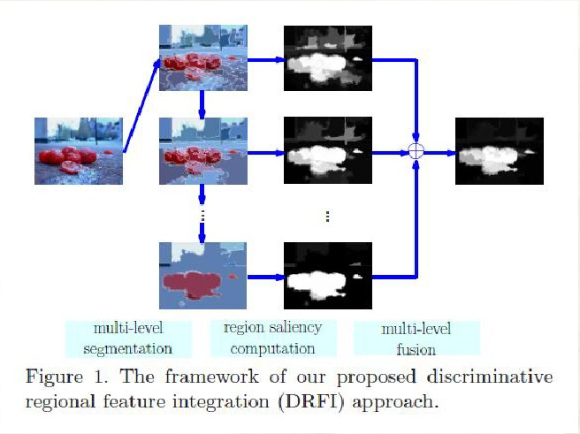
Framework:
1.multi-level segmentation
多层次分割
2.Region saliency computation
区域显著性值计算
3.multi-level fusion
多层次融合

Slide 3
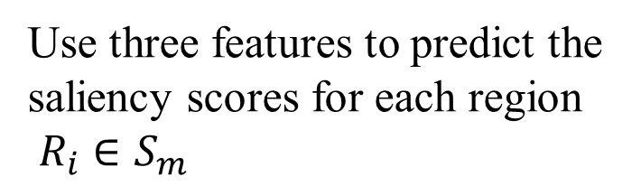
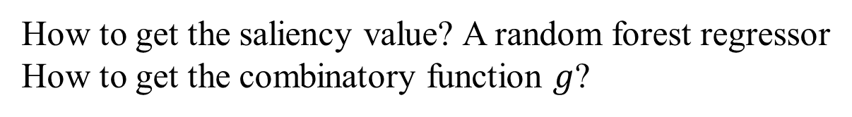
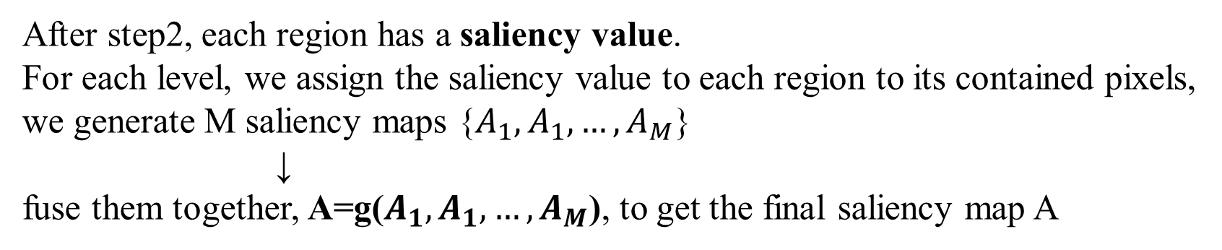
Step1:Given an image I →a set of M-level segmentations S={$S_{1},$ $S_{2},…,S_{M},$}
Regional contrast descriptor
Regional backgroundness descriptor
Regional property descriptor
Step2:
Use three features to predict the
saliency scores for each region
$R_{i}∈S_{m}$
→
Step3:
After step2, each region has a saliency value.
For each level, we assign the saliency value to each region to its contained pixels,
we generate M saliency maps {$A_{1},A_{1},…,A_{M}$}
↓
fuse them together, A=g($A_{1},A_{1},…,A_{M}$), to get the final saliency map A
How to get the saliency value? A random forest regressor
How to get the combinatory function $g$?
→
Learning from data

Slide 4
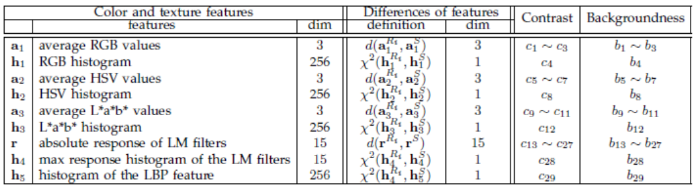
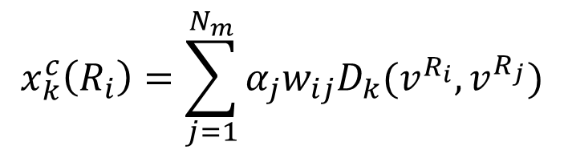
Regional contrast descriptor
describe it by a 29 dimensional feature vector
$$x_{k}^{c}\left(R_{i}\right)=\sum_{j=1}^{N_{m}}{α_{j}w_{ij}D_{k}(v^{R_{i}},v^{R_{j}})}$$

Slide 5

Regional backgroundness descriptor
describe it by a 29 dimensional feature vector
$$x_{k}^{b}\left(R_{i}\right)=D_{k}(v^{R_{i}},v^{B})$$

Slide 6
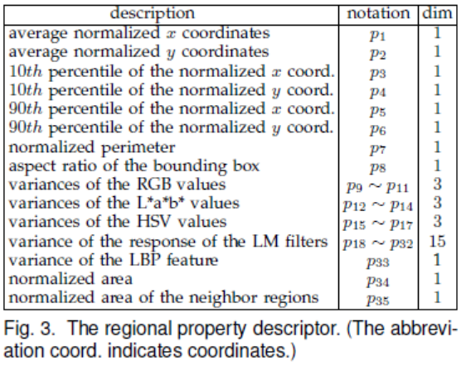
Regional property descriptor
describe it by a 29 dimensional feature vector
Appearance
colors and textures
Geometric features
size and position of the region

Slide 7
Step1:Given an image I →a set of M-level segmentations S={$S_{1},$ $S_{2},…,S_{M},$}
Regional contrast descriptor
Regional backgroundness descriptor
Regional property descriptor
Step2:
Use three features to predict the
saliency scores for each region
$R_{i}∈S_{m}$
→
Step3:
After step2, each region has a saliency value.
For each level, we assign the saliency value to each region to its contained pixels,
we generate M saliency maps {$A_{1},A_{1},…,A_{M}$}
↓
fuse them together, A=g($A_{1},A_{1},…,A_{M}$), to get the final saliency map A
How to get the saliency value? A random forest regressor
How to get the combinatory function $g$?
→
Learning from data

Slide 8
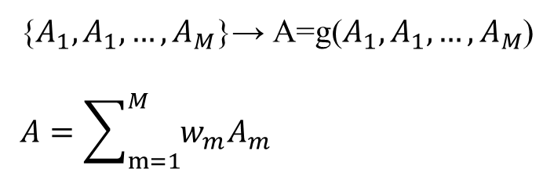
Learning
Generating training samples
Learning the regional saliency regressor
Learning the multi-level saliency fusor
{$A_{1},A_{1},…,A_{M}$}→ A=g($A_{1},A_{1},…,A_{M}$)
$$A=\sum_{m=1}^{M}{w_{m}A_{m}}$$

